Slide 1














Full Stack Development Tools Overview
Essential Technologies for Modern Web Development
A comprehensive exploration of the fundamental tools and frameworks that power today's full-stack applications 4 from front-end design to back-end architecture, version control to database management.
Postman
API development & testing platform
Eclipse
Integrated development environment
Java
Object-oriented programming language
HTML
Markup language structure
CSS
Stylesheet & visual design
GitHub
Version control & collaboration
MySQL
Relational database management
Presented by
Sanjana H
Information Science & Engineering
Academic Details
Institution: CEC
Presentation Date: 8th October 2025
Tejashwini M H
Information Science & Engineering
Building the future of web development, one tool at a time.

Slide 2








Today's Journey Through Software Development
Welcome to an exploration of essential software development tools and technologies. From API testing to database management, we'll cover the fundamental building blocks that power modern web applications and development workflows.
Introduction
Setting the stage for our technical journey
Postman
API testing and collaboration tool
Eclipse
Popular Java Integrated Development Environment
Java
Core programming language fundamentals
HTML
Building blocks of web pages
CSS
Styling and layout for web design
GitHub
Version control and code collaboration platform
MySQL
Relational database management system
Project Explanation
Overview and objectives
Summary
Key takeaways from our session
QFA
Your questions answered
Each topic builds upon the previous, creating a comprehensive understanding of the modern development ecosystem. Let's begin our exploration.

Slide 3

Introduction to Full-Stack Development
Complete Overview
Full-stack development encompasses both frontend and backend technologies, creating seamless web applications from database to user interface.
Why These Tools Matter
Each tool in our stack serves a specific purpose, working together to streamline development, testing, and deployment processes.
Today's Focus
We'll explore seven essential tools: Postman, Eclipse IDE, Java, HTML, CSS, GitHub, and MySQL 4 the foundation of modern web development.

Slide 4

Postman: API Testing Made Simple
Purpose
Postman is your primary tool for API testing and debugging, allowing you to validate backend functionality before frontend integration.
Key Features
Create and test REST APIs with intuitive interface
Automate test cases for consistent quality assurance
Organise with collections and manage multiple environments
Practical Example
Test a login API endpoint thoroughly before connecting it to your user interface, catching potential errors early in development.

Slide 5
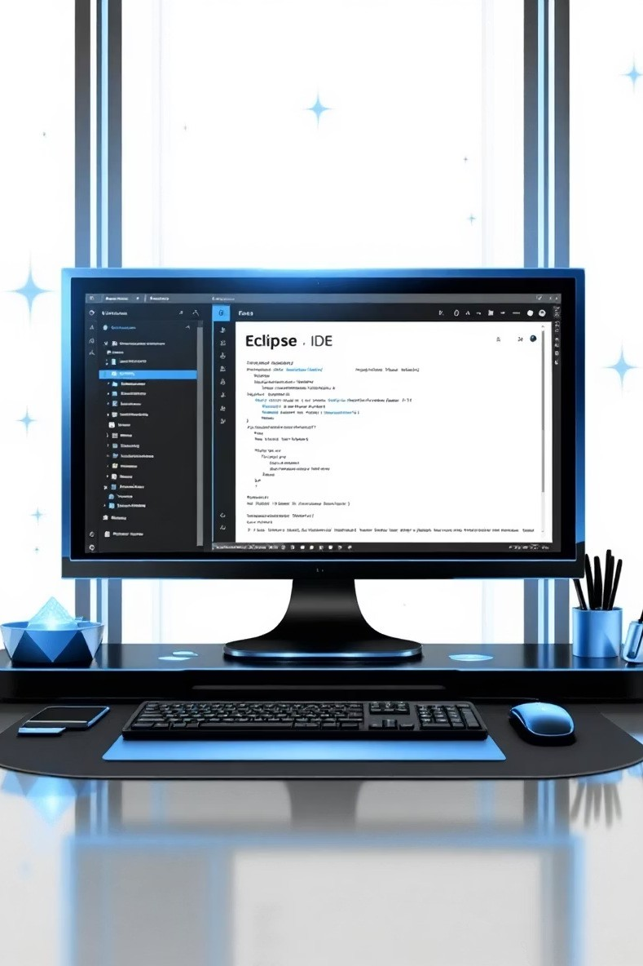
Eclipse IDE: Your Java Development Hub
Development Platform
Eclipse provides a comprehensive integrated development environment specifically optimised for Java programming and backend API development.
Essential Features
Advanced code editing with intelligent suggestions Built-in debugging tools for troubleshooting
Build automation for efficient compilation
Maven and Git plugins for dependency management

Slide 6
Java: The Backbone of Backend Logic
Core Programming Language
Java serves as the primary backend language, powering server- side logic and business rules for your applications.
Key Highlights
Object-oriented: Promotes clean, modular code structure
Platform independent: Write once, run anywhere capability
Rich library support: Extensive frameworks and tools available
Sample Code
public class Welcome {
public static void main(String[] args) { System.out.println("Welcome to Full Stack
Development!");
}
}
Simple yet powerful 4 Java's syntax is clear and readable for beginners whilst remaining robust for complex applications.

Slide 7
HTML: Building Web Page Structure
Foundation of Web Pages
HTML (HyperText Markup Language) provides the structural skeleton of every webpage, defining content organisation and hierarchy.
Sample HTML Code
<h2>Login Form</h2>
<form>
<input type="text" placeholder="Username">
<input type="password" placeholder="Password">
<button type="submit">Login</button>
</form>
Practical Example
Creating a login form with semantic HTML ensures accessibility and proper content structure for your users.

Slide 8

CSS: Bringing Design to Life
Purpose
CSS (Cascading Style Sheets) transforms plain HTML into visually appealing, professional interfaces through styling and layout control.
Example Styling
form {
border: 1px solid #ccc; padding: 20px; background: #f9f9f9; border-radius: 8px;
box-shadow: 0 2px 4px rgba(0,0,0,0.1);
}
Enhanced User Experience
Proper CSS implementation dramatically improves UI/UX, creating intuitive interfaces that users enjoy interacting with.

Slide 9
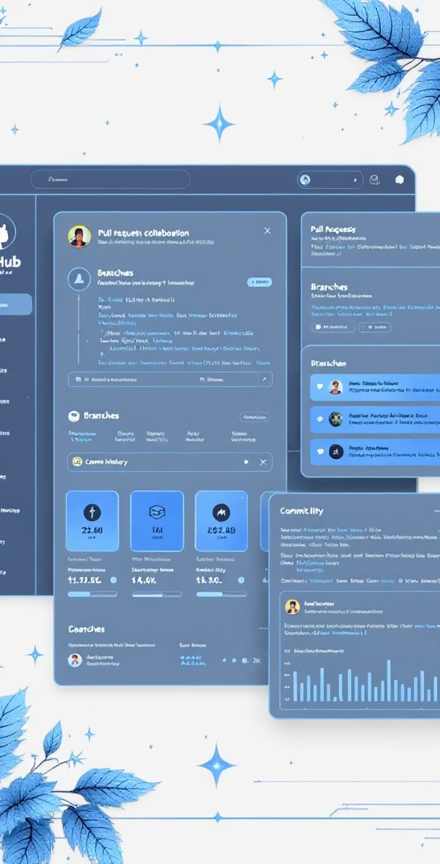
GitHub: Version Control F Collaboration
01
Version Management
Track every change in your codebase, allowing you to revert mistakes and maintain a complete project history.
02
Branching F Merging
Work on features independently through branches, then seamlessly integrate changes into the main codebase.
03
Team Collaboration
Multiple developers can work simultaneously without conflicts, reviewing and approving each other's contributions.
04
CI/CD Integration
Connect automated testing and deployment pipelines directly to your repository for streamlined delivery.

Slide 10
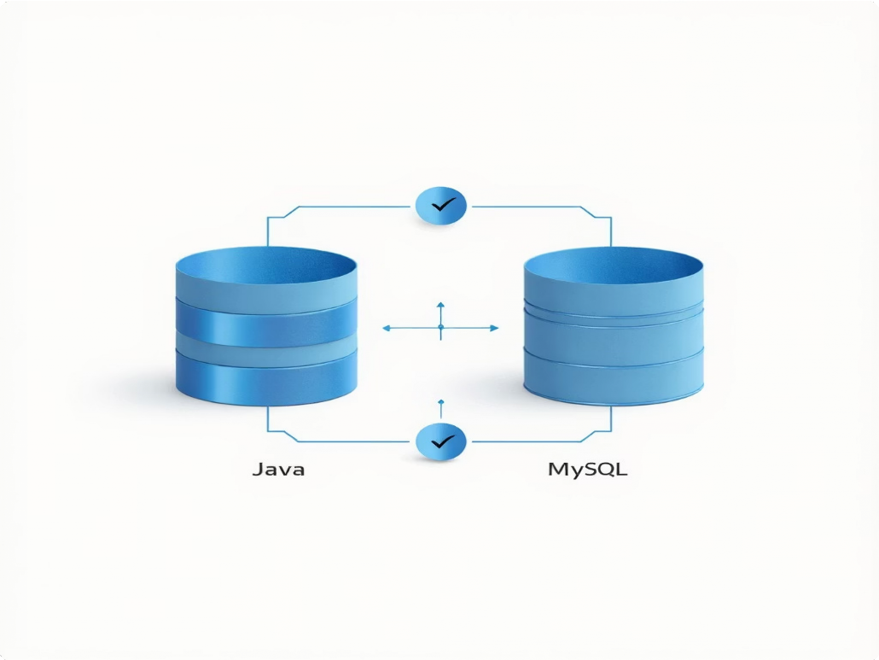
MySQL: Database Foundation
Purpose
MySQL serves as your backend database, reliably storing and retrieving application data with efficient query processing.
Example Query
CREATE TABLE users (
id INT AUTO_INCREMENT PRIMARY KEY, username VARCHAR(50) NOT NULL, password VARCHAR(255) NOT NULL, email VARCHAR(100),
created_at TIMESTAMP DEFAULT CURRENT_TIMESTAMP
);
Java Integration
Connect your Java backend to MySQL using JDBC (Java Database Connectivity), enabling seamless data operations.
This integration allows your application to perform CRUD operations efficiently and securely.

Slide 11






Bringing It All Together
Employee Management System Example
A complete web-based application demonstrating how all tools work in harmony to create a functional CRUD system.
Frontend
HTML/CSS creates the user interface, collecting employee data through forms
Backend
Java processes requests, validates data, and manages business logic
Database
MySQL stores and retrieves employee information securely
Development Workflow
Tool
Role in Project
HTML/CSS | Frontend user interface and styling
Java (Eclipse) | Backend logic and API endpoints
MySQL | Data storage and retrieval
Postman | API testing and validation
GitHub
Version control and collaboration
Complete CRUD operations
Create, read, update, and delete employee records seamlessly
Integrated testing
Validate all API endpoints using Postman before deployment
Robust database connectivity
Reliable MySQL integration through JDBC
Professional version control
Track changes and collaborate effectively via GitHub

Slide 12
INCLUDED SECTIONS
Development Environment: Setup with Postman, Eclipse, and GitHub. Core Languages: Master Java, HTML, and CSS for the stack.
Data Management: Utilize MySQL for robust database operations. Project Integration: Apply skills to a final, practical application.

Slide 13
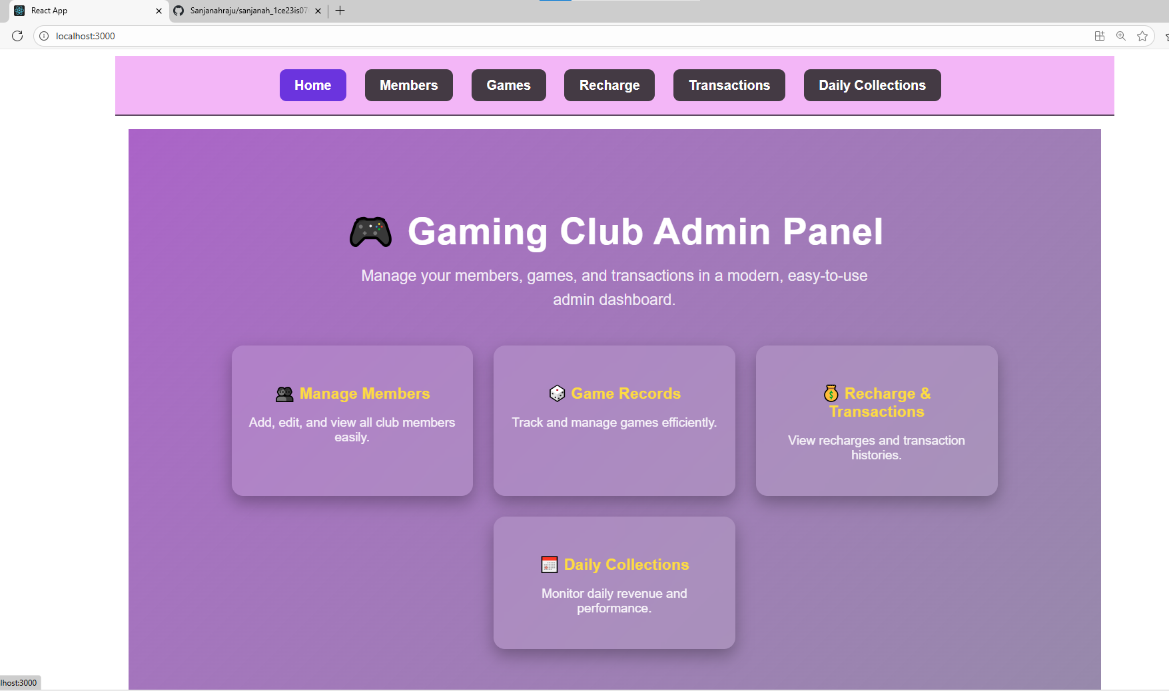

Slide 14
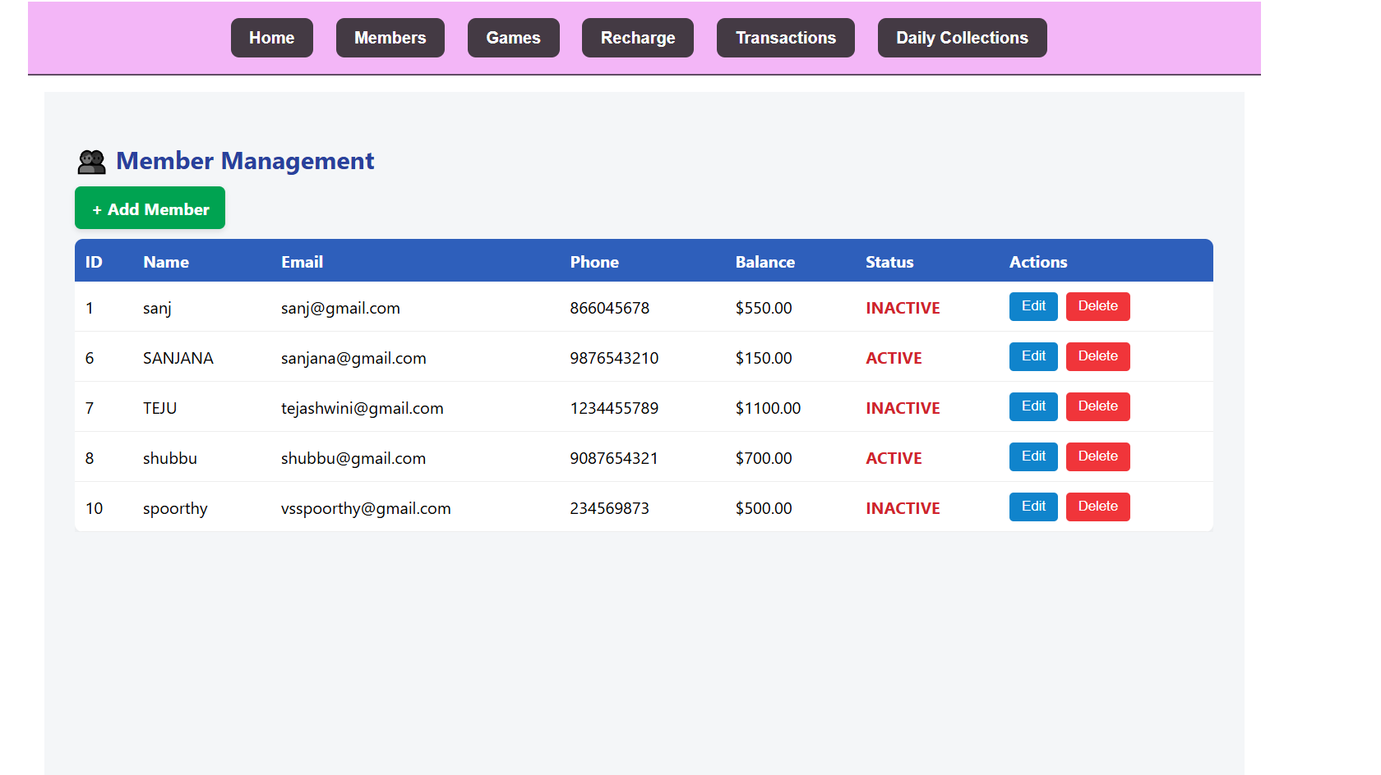

Slide 15
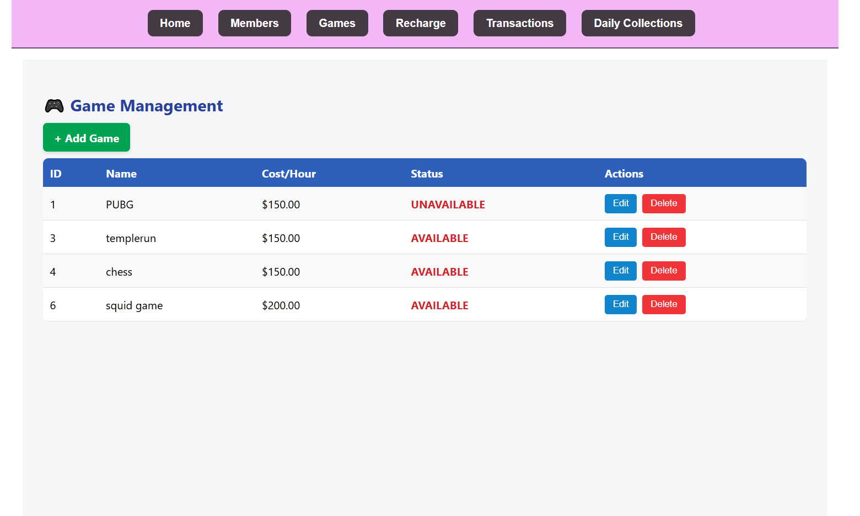

Slide 16
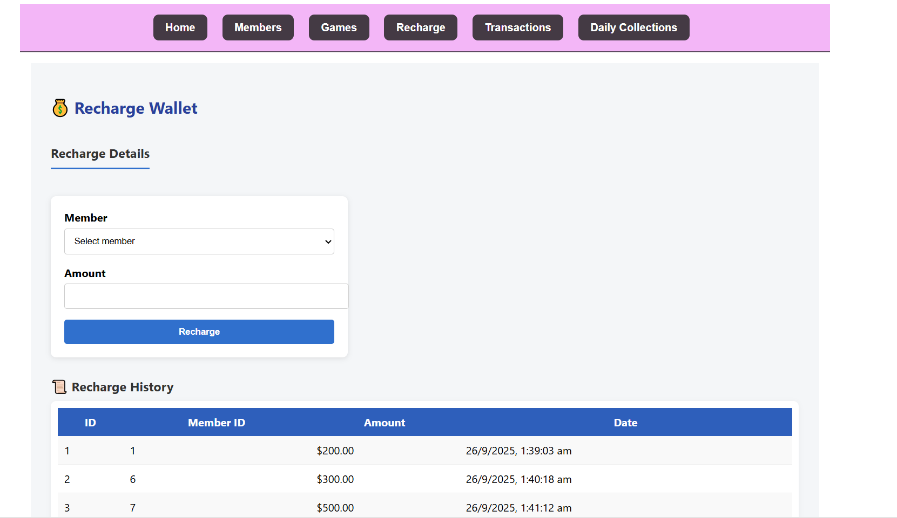

Slide 17
